Slide 1
A Mobile Sensor Network to Map CO₂ in Urban Environments
Joey Lee¹, Andreas Christen¹, Zoran Nesic², & Rick Ketler¹
Department of Geography¹
Department of Land and Food Systems²
The University of British Columbia
9th International Conference on Urban Climate
Toulouse, France
July 24, 2015

Slide 2
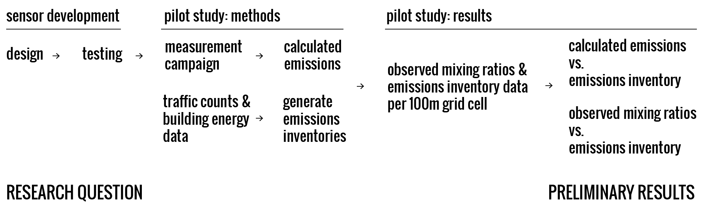
Overview
We present a pilot study to show the potential for a mobile sensor network to monitor greenhouse gases (GHGs) in cities.

Slide 3
Research Question
Can we map greenhouse gases and other pollutants, specifically CO₂, at high spatio-temporal resolution across the city with a network of mobile sensors?

Slide 4
Motivations: Why Mobile Sensing?

Slide 5
Motivations: Why Mobile Sensing?
Cities are a major source of GHGs into the atmosphere (Estimated 70%, Rosenzweig 2010).

Slide 6
Motivations: Why Mobile Sensing?
Cities are a major source of GHGs into the atmosphere (Estimated 70%, Rosenzweig 2010).
Currently there are a lack of tools to monitor GHGs in cities; existing tools are limited by funding, time, expertise, spatial & temporal resolution.

Slide 7
Motivations: Why Mobile Sensing?
Cities are a major source of GHGs into the atmosphere (Estimated 70%, Rosenzweig 2010).
Currently there are a lack of tools to monitor GHGs in cities; existing tools are limited by funding, time, expertise, spatial & temporal resolution.
There’s a need to validate models & remote sensing methods.

Slide 8
Motivations: Why Mobile Sensing?
Cities are a major source of GHGs into the atmosphere (Estimated 70%, Rosenzweig 2010).
Currently there are a lack of tools to monitor GHGs in cities; existing tools are limited by funding, time, expertise, spatial & temporal resolution.
There’s a need to validate models & remote sensing methods.
Opportunities exist to use existing infrastructure such public and private vehicles and bikes to sample intensively & extensively.

Slide 9
The Mobile Sensor System

Slide 10
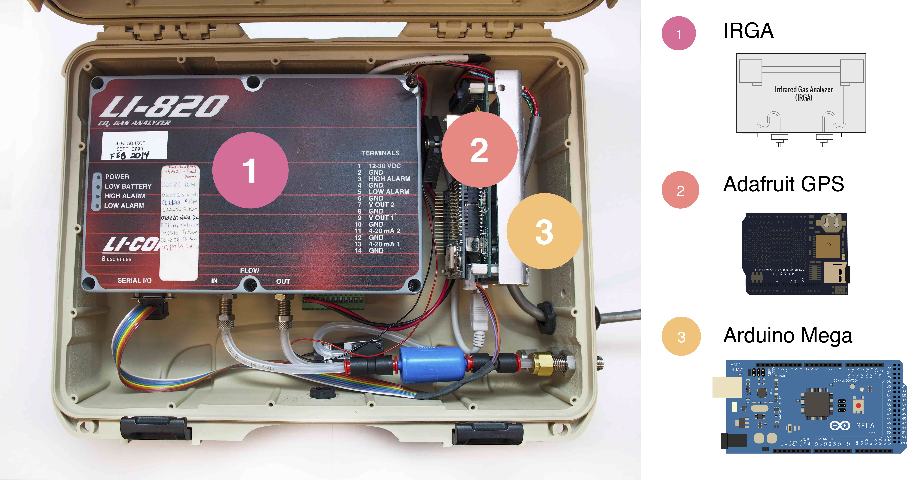
System Components
1. IRGA – Licor LI-820 (Licor Inc, Lincoln, NB, USA), 2. Adafruit GPS (Adafruit Industries, Manhattan, NY, USA), 3. Arduino Mega (Arduino CC, Ivrea, Italy) . *Not Shown: OneWire Digital Temperature Thermometer (Maxim Integrated One Wire Digital Temperature Sensor - DS18B20, San Jose, CA, USA )

Slide 11
System Specifications

Slide 12
System Specifications
Runs on 12 V Power supply

Slide 13
System Specifications
Runs on 12 V Power supply
Measures CO₂ mixing ratios (ppm), geoposition and speed, and air temperature at 1-second intervals.

Slide 14
System Specifications
Runs on 12 V Power supply
Measures CO₂ mixing ratios (ppm), geoposition and speed, and air temperature at 1-second intervals.
Size: 35.8 cm x 27.8 cm x 11.8 cm, weight: 2.6 kg.

Slide 15
System Specifications
Runs on 12 V Power supply
Measures CO₂ mixing ratios (ppm), geoposition and speed, and air temperature at 1-second intervals.
Size: 35.8 cm x 27.8 cm x 11.8 cm, weight: 2.6 kg.
Precision: +/- 1.1 ppm

Slide 16
System Specifications
Runs on 12 V Power supply
Measures CO₂ mixing ratios (ppm), geoposition and speed, and air temperature at 1-second intervals.
Size: 35.8 cm x 27.8 cm x 11.8 cm, weight: 2.6 kg.
Precision: +/- 1.1 ppm
Accuracy: +/- 3 ppm, with maximum drift of +/- 4 ppm over seven days.

Slide 17
System Specifications
Runs on 12 V Power supply
Measures CO₂ mixing ratios (ppm), geoposition and speed, and air temperature at 1-second intervals.
Size: 35.8 cm x 27.8 cm x 11.8 cm, weight: 2.6 kg.
Precision: +/- 1.1 ppm
Accuracy: +/- 3 ppm, with maximum drift of +/- 4 ppm over seven days.
Total delayed response time: 13 s with 3 m sample tube at flow rate of 700 cc/min.

Slide 18
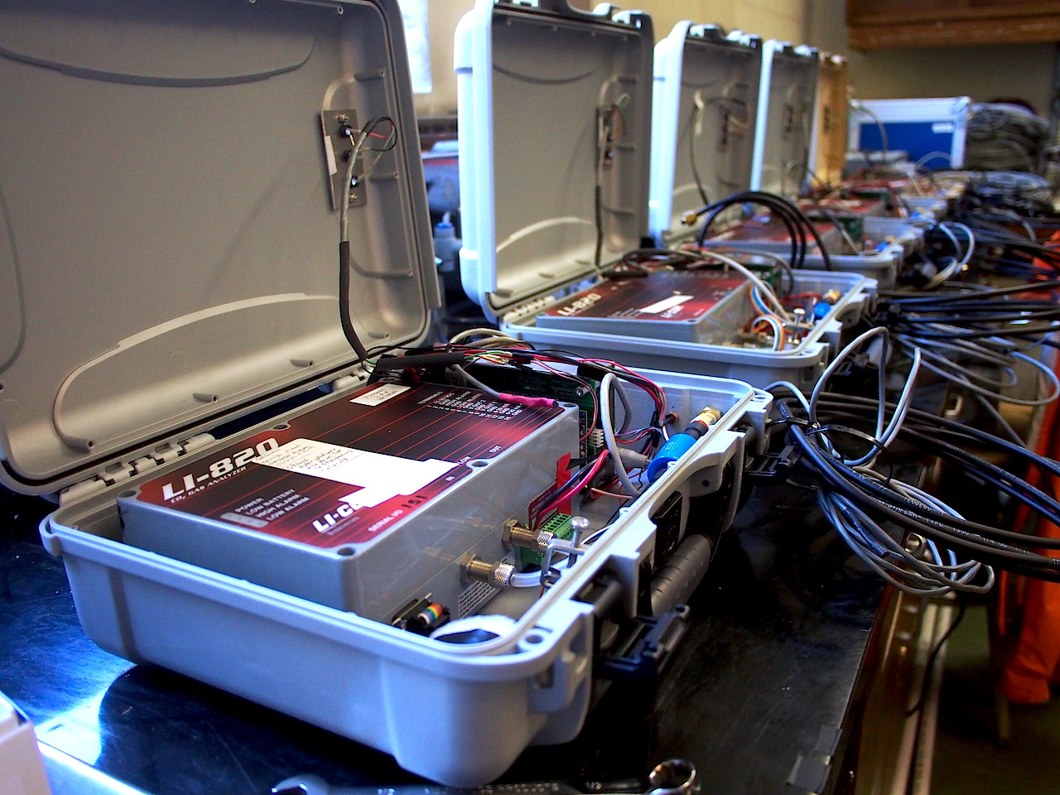
Built & Tested: 5 mobile systems
Image: In total 5 sensors were built – the image shows the full setup including the sample inlet tube and the temperature probes.

Slide 19
Pilot Study – Methods: Measurement Campaign

Slide 20
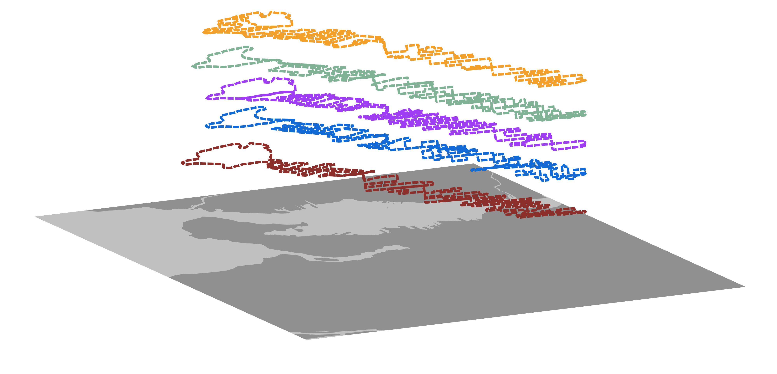
Overview: Measurement Campaign
5 transects simultaneously – each approx. 70km
Transects planned to cover (almost) all navigable roads.
Vehicle & Bike Based
Image: The image shows 5 planned transect routes for the measurement campaign

Slide 21
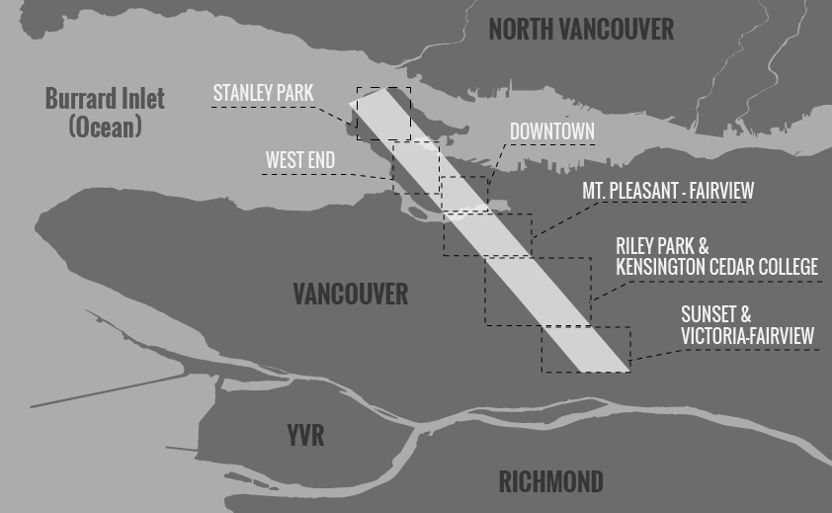
Study Area: 12.7 km² transect, Vancouver, BC
Image: 12 km² transect study area in Vancouver, BC. The transect is 1km x 12.7km covering the major land cover types in the city.

Slide 22
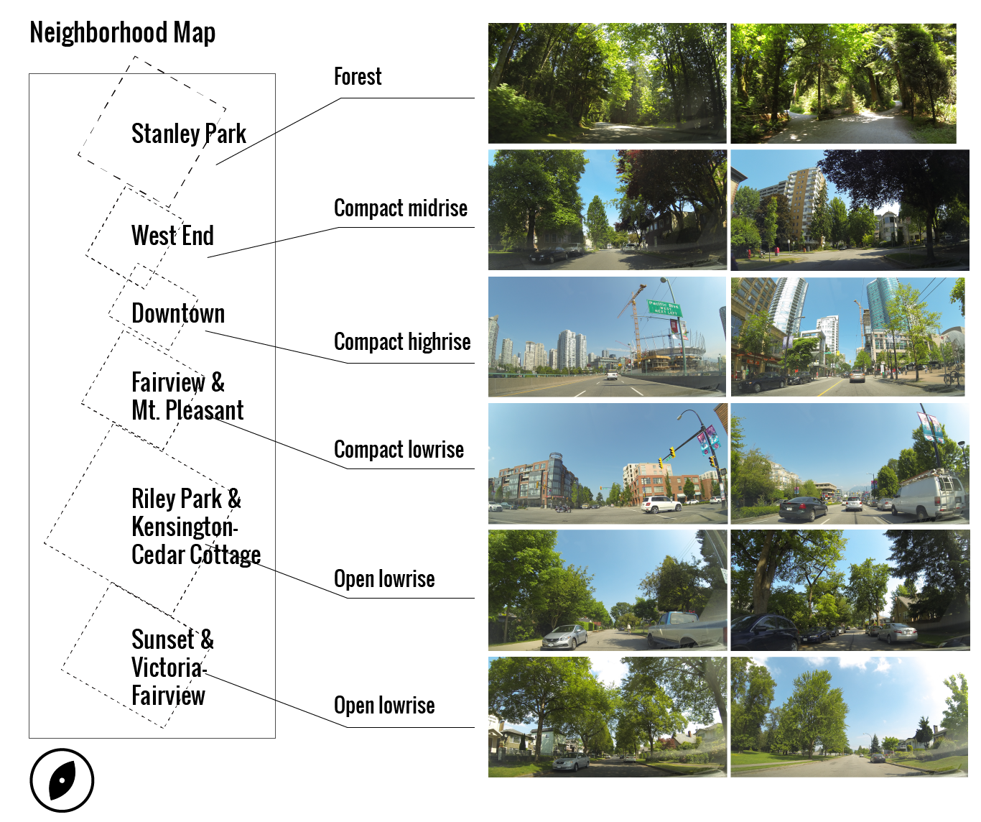
Study Area: Local Climate Zones
Image: The images above show typical urban features characteristic for each neighborhood in the study area and were taken with a dashboard camera during the measurement campaign.

Slide 23
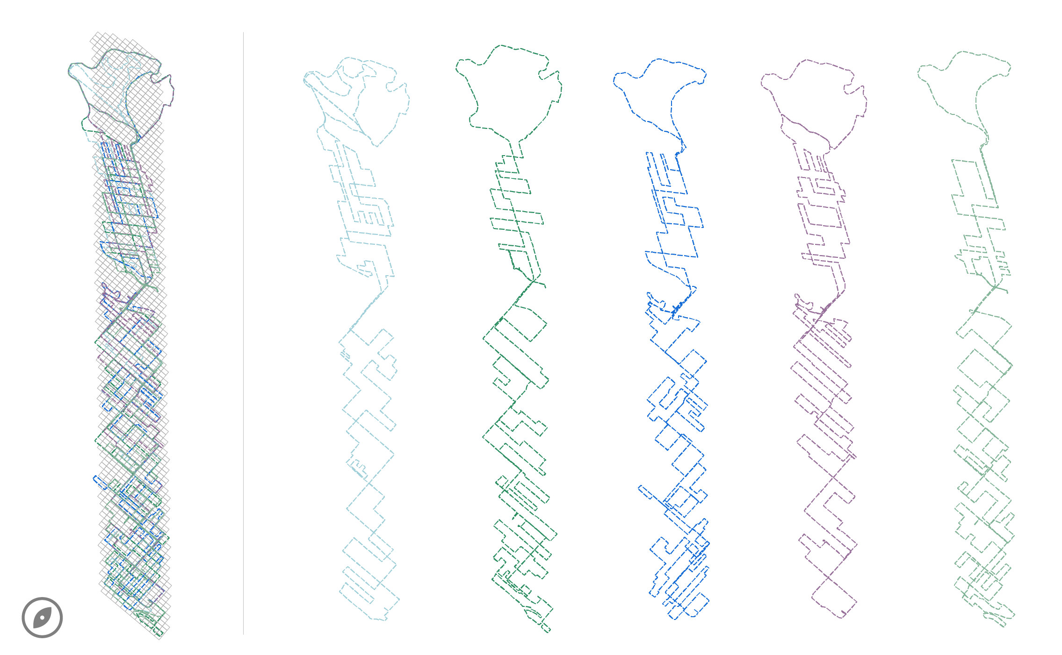
Sampling Methods: Deployment Transects
Image: The image shows 5 planned transect routes for the measurement campaign. Goal: to cover (almost) all navigable roads (and some trails) along the transect in 3.5 hours.

Slide 24
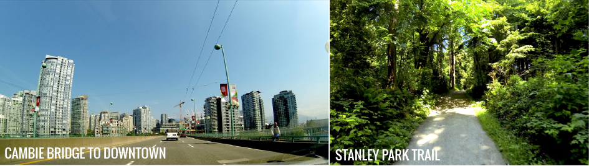
Study Area: Meteorology
Temperature: 20° - 22° C.
Weak winds: 2.5 m/s at 30m height above city.
Sunny, cloudless - late spring, early summer, day.
Measurement period: 10:30 – 14:00, May 25th, 2015
* data measured at Urban Climate Tower "Vancouver Sunset" (SE section of Transect)

Slide 25
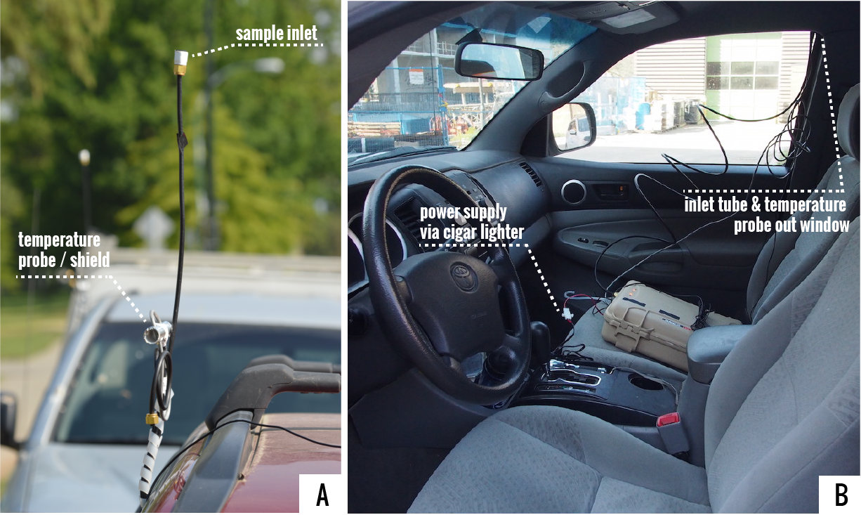
Sampling Methods: Vehicle Installation
Image A: Shows the temperature probe covered by PVC tube and reflective tape and sample inlet tube at 2m height - ±0.5°C Accuracy from -10°C to +85°C ; Image B: Shows sensor installation in vehicle.

Slide 26
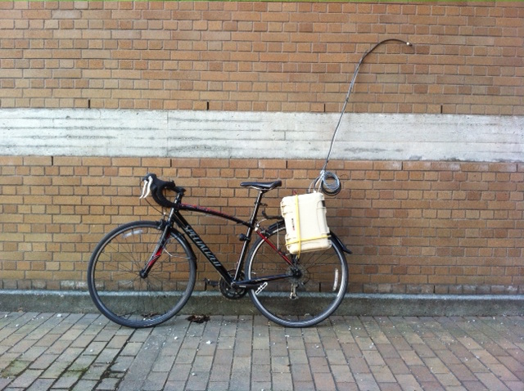
Sampling Methods: Bike Installation
Image: Shows the installation of the sensor on a bike rack – the inlet is at approximately 2m height.

Slide 27
Pilot Study – Methods: Emissions Inventory & Mapping

Slide 28
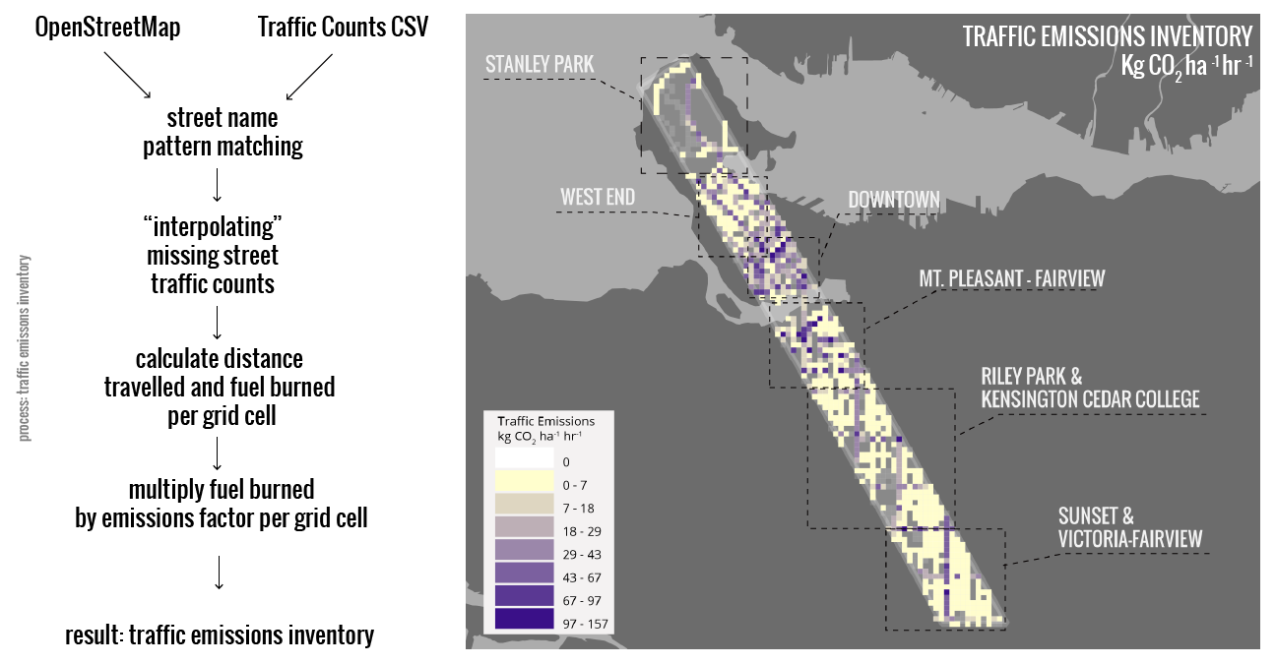
Traffic Emissions Inventory
Image: The traffic emissions inventory derived from Vancouver’s traffic count data and calculated per grid cell using fuel consumption and emissions factors.

Slide 29
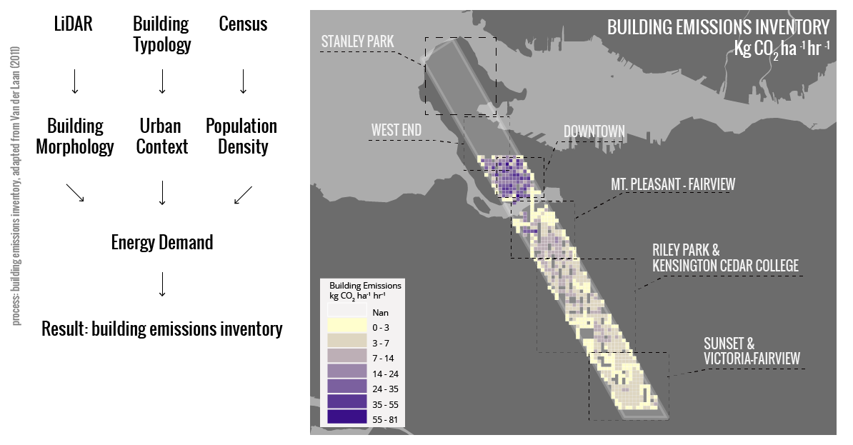
Building Emissions Inventory
Image: Building emissions inventory generated by combining factors of building morphology, urban context, and population density derived from LiDAR, building topology, and census data.

Slide 30
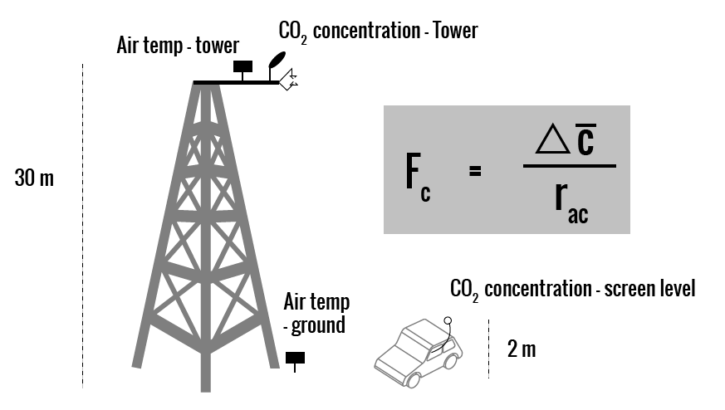
Calculated Emissions: Aerodynamic
Resistance Approach
Image: Illustration of aerodynamic resistance approach used to calculate the CO2 emissions map.

Slide 31
Pilot Study - Mapping CO₂ Emissions: Results

Slide 32
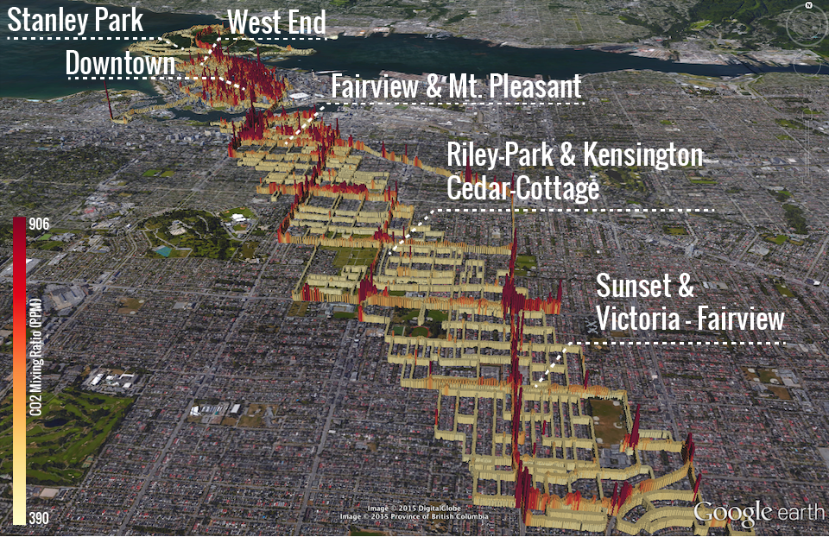
Raw Data: Visualized in Google Earth

Slide 33
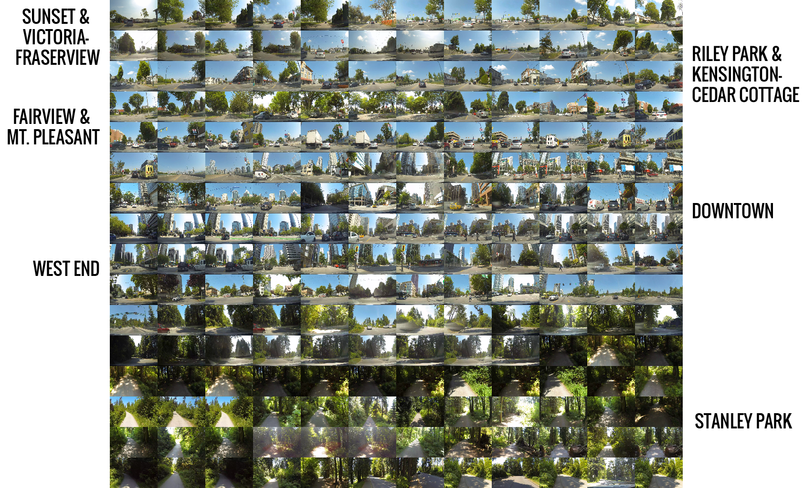
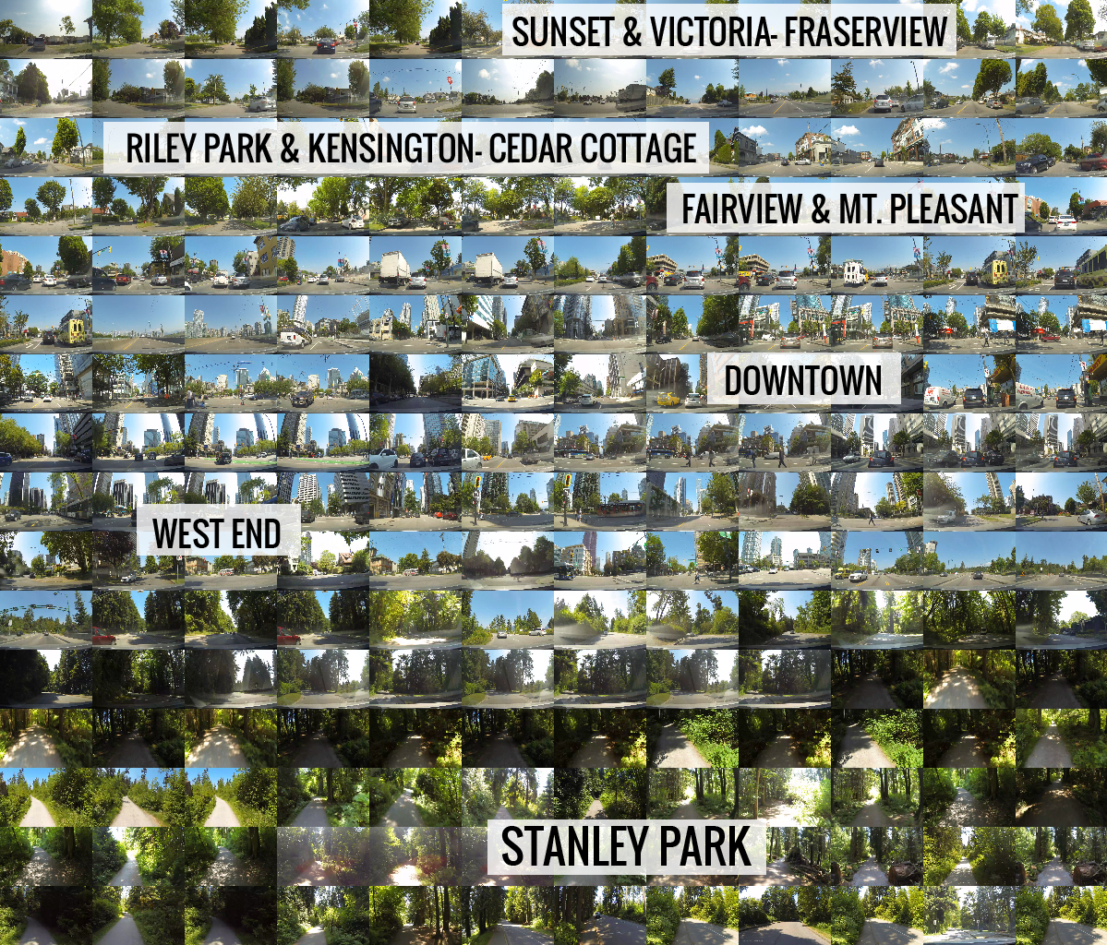
Transect: Deployment Images

Slide 34
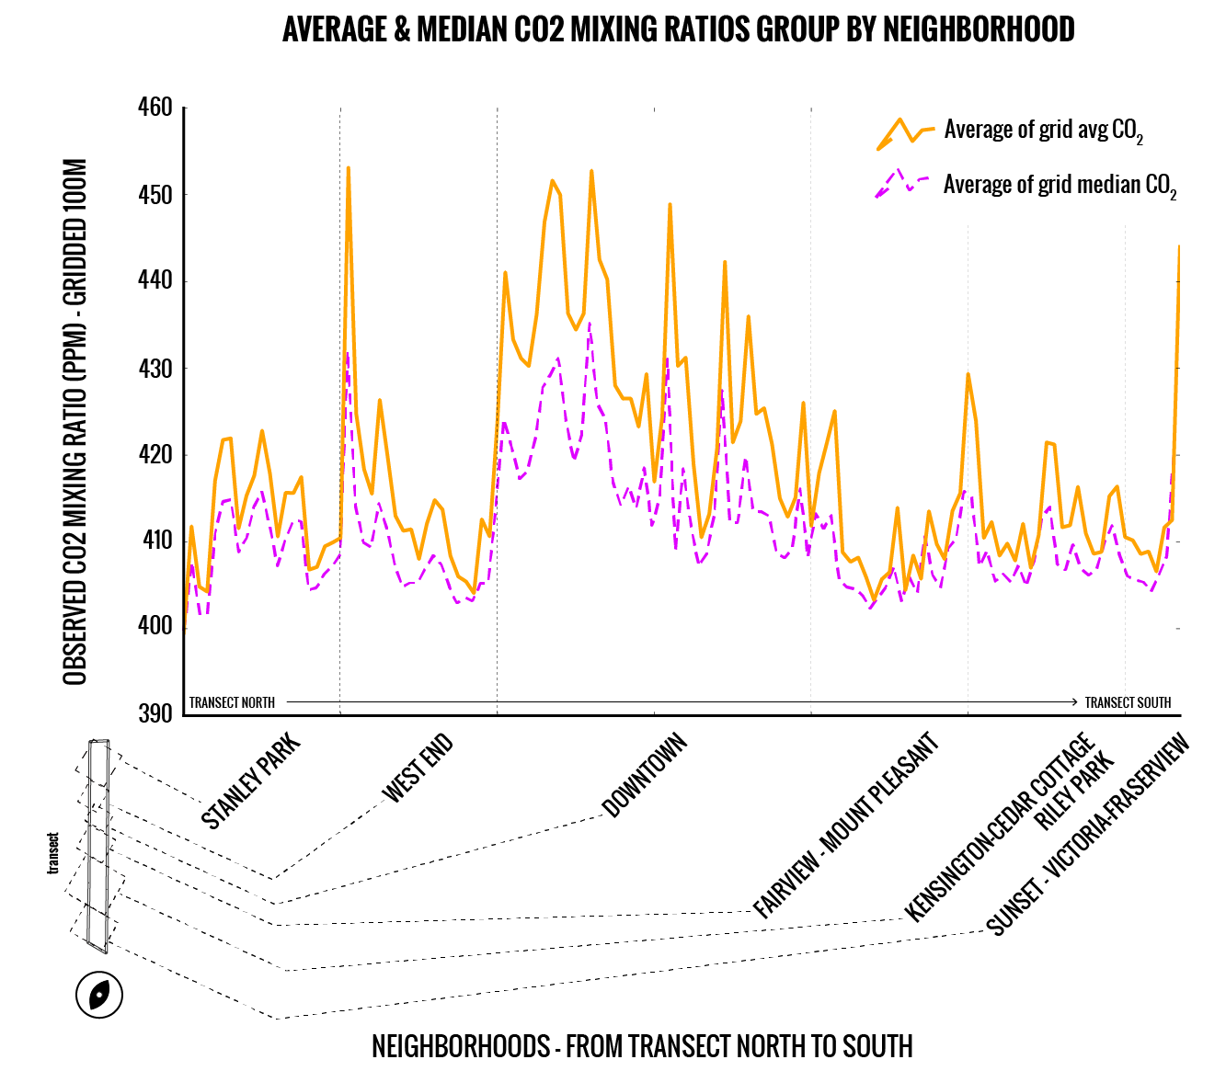
Observed Mixing Ratios: Average & Median
per 100m grid cell by neighborhood

Slide 35
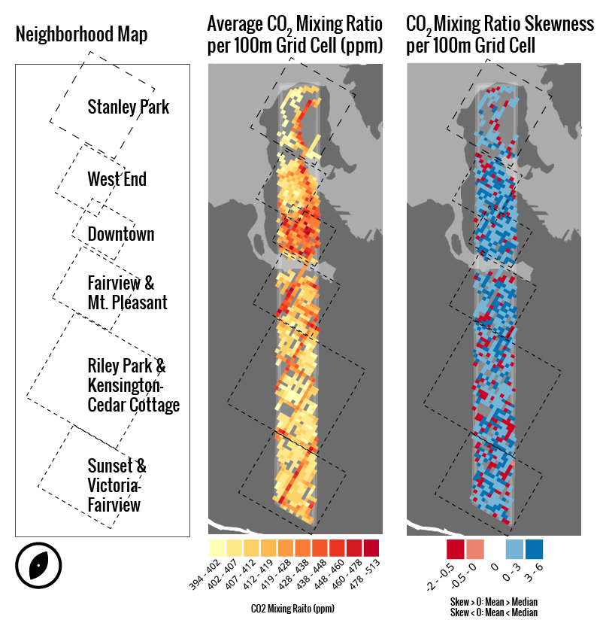
Observed Mixing Ratios: Average CO₂ & Skewness
per 100m Grid Cell

Slide 36
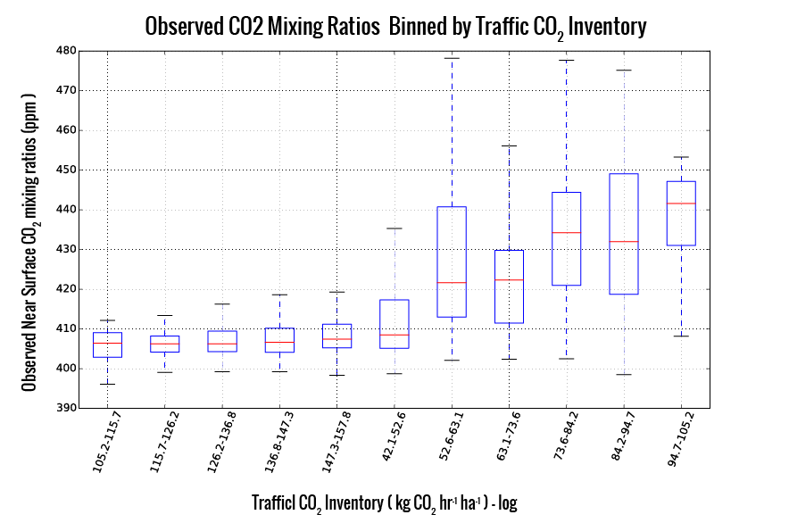
CO₂ Mixing Ratios Vs. Traffic Emissions Inventory

Slide 37
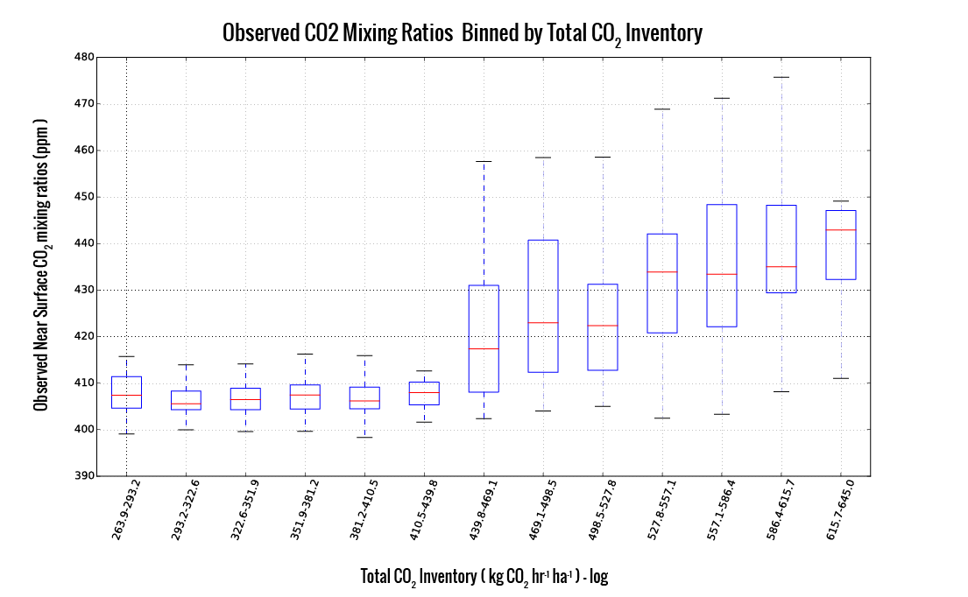
CO₂ Mixing Ratios Vs. Total Emissions Inventory

Slide 38
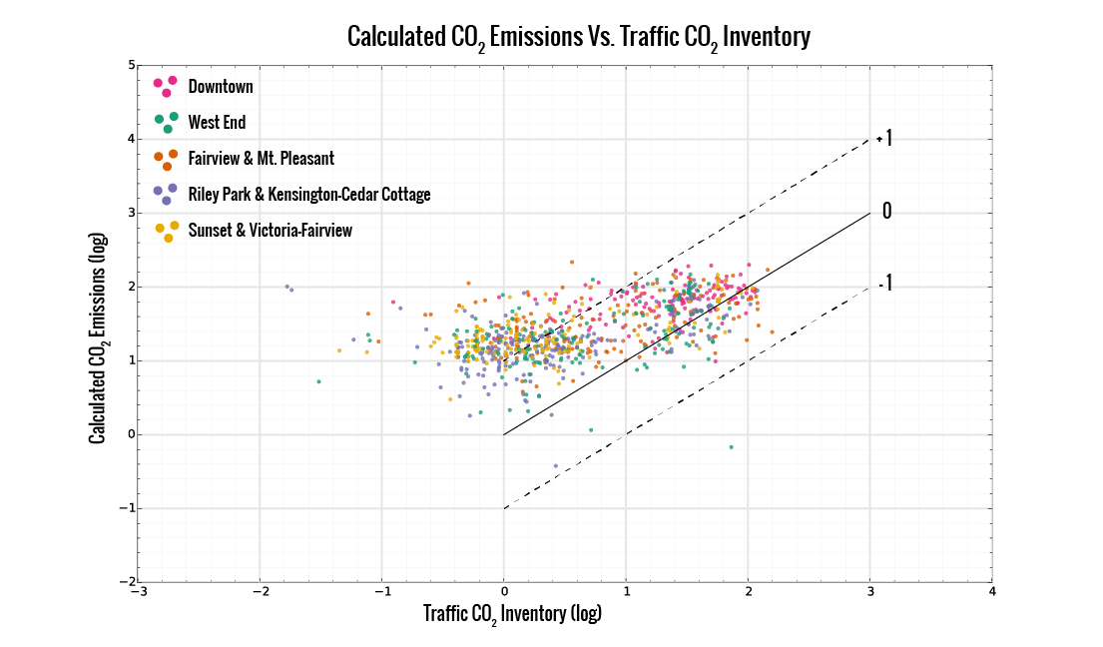
Calculated CO₂ emissions vs. Traffic Emissions Inventory

Slide 39
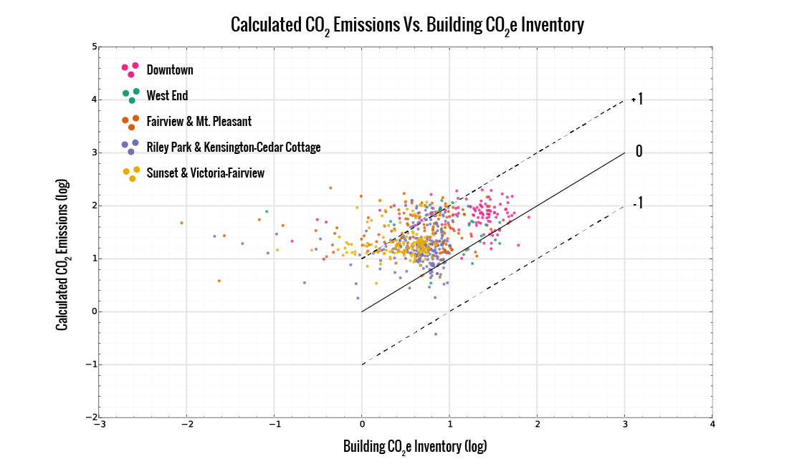
Calculated CO₂ emissions vs. Building Emissions Inventory

Slide 40
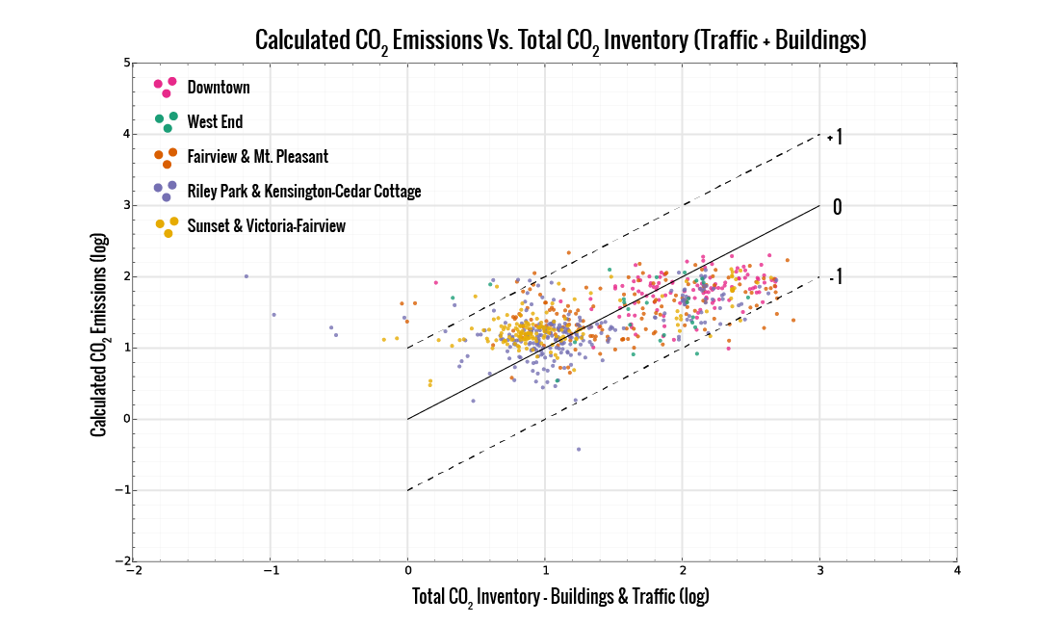
Calculated CO₂ emissions vs. Total Emissions Inventory

Slide 41
Calculated CO2 Emissions over- and -under- estimation areas.

Slide 42
Conclusions & Future Directions

Slide 43
Conclusions & Future Directions
A mobile CO₂ sensing system was developed using opensource components.

Slide 44
Conclusions & Future Directions
A mobile CO₂ sensing system was developed using opensource components.
The system was tested in Vancouver and evaluated against traffic and building emissions inventories.

Slide 45
Conclusions & Future Directions
A mobile CO₂ sensing system was developed using opensource components.
The system was tested in Vancouver and evaluated against traffic and building emissions inventories.
The study shows the potential for pervasive mobile sensing in GHG and pollutant monitoring in cities.

Slide 46
Conclusions & Future Directions
A mobile CO₂ sensing system was developed using opensource components.
The system was tested in Vancouver and evaluated against traffic and building emissions inventories.
The study shows the potential for pervasive mobile sensing in GHG and pollutant monitoring in cities.
Currently exploring visualization & feedback opportunities for planning and open science.

Slide 47
Conclusions & Future Directions
A mobile CO₂ sensing system was developed using opensource components.
The system was tested in Vancouver and evaluated against traffic and building emissions inventories.
The study shows the potential for pervasive mobile sensing in GHG and pollutant monitoring in cities.
Currently exploring visualization & feedback opportunities for planning and open science.
Collaboration potential with local mobility providers for long term & spatially extensive/intensive monitoring

Slide 48
Conclusions & Future Directions

Slide 49
Conclusions & Future Directions
Mobile CO2 sensing shows potential to map emissions.

Slide 50
Conclusions & Future Directions
Mobile CO2 sensing shows potential to map emissions.
Potential applications for pollutant mapping.

Slide 51
Conclusions & Future Directions
Mobile CO2 sensing shows potential to map emissions.
Potential applications for pollutant mapping.
Visualization & feedback opportunities in progress.

Slide 52
Conclusions & Future Directions
Mobile CO2 sensing shows potential to map emissions.
Potential applications for pollutant mapping.
Visualization & feedback opportunities in progress.
Collaboration potential with local mobility providers for long term & spatially extensive/intensive monitoring

Slide 53
Recap

Slide 54
Recap
A Mobile CO2 sensing system was developed using opensource components.

Slide 55
Recap
A Mobile CO2 sensing system was developed using opensource components.
The system was tested in Vancouver and evaluated against traffic and building emissions inventories.

Slide 56
Recap
A Mobile CO2 sensing system was developed using opensource components.
The system was tested in Vancouver and evaluated against traffic and building emissions inventories.
The study shows the potential for pervasive mobile sensing in GHG and pollutant monitoring in cities.

Slide 57
Recap
A Mobile CO2 sensing system was developed using opensource components.
The system was tested in Vancouver and evaluated against traffic and building emissions inventories.
The study shows the potential for pervasive mobile sensing in GHG and pollutant monitoring in cities.
Future opportunities exist for long term monitoring and to provide feedback through visualization

Slide 58
Acknowledgements & Funding
NSERC Discovery Grant
NSERC CREATE - Terrestrial Ecosystems Research and World Wide Education & Broadcast Program (TerreWEB).
UBC Geography Department
Benedikt Groß, 47Nord GmBH, & Moovel Labs
Measurement Campaign Drivers: Alex McMahon, Andreas Christen, Mark Richardson, & Thea Rodgers.
ICUC & IAUC
Data: OpenStreetMap.org, Vancouver Open Data, EPiCC Project, UBC Micrometeorology
Tools: Python, R, QGIS, GDAL/OGR, Processing
References
Van der Laan, "Scaling Urban Energy Use and Greenhouse Gas Emissions through LiDAR", MSc Thesis, 2011.
Rosenzweig, C., Solecki, W., and Hammer, S. A. (2010). Cities lead the way inclimate-change action. Nature, pages 1–3.

Slide 59
Special thanks to Andreas, Zoran, and Rick for countless hours dedicated to the project.

Slide 60
The slides & links can be found on github:
joeyklee.github.io/presentations/ICUC-JLEE-2015

Slide 61
Thanks!
Questions? Comments?
Many thanks to ICUC organizers and community.

